Slide 1
Moment Integrals
Dr. Jacob Moore
Associate Professor of Mechanical Engineering
Penn State Mont Alto

Slide 2
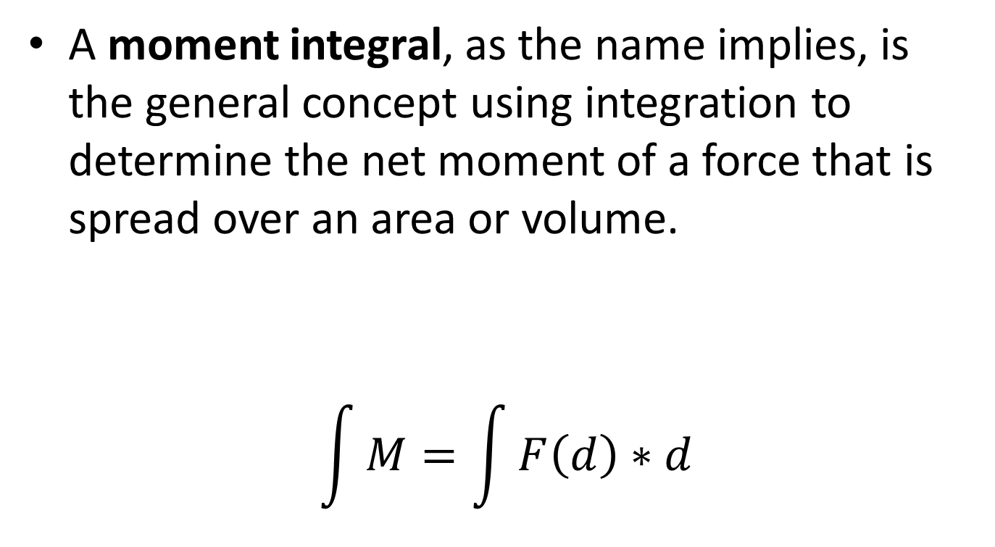
What is a “Moment Integral”
A moment integral, as the name implies, is the general concept using integration to determine the net moment of a force that is spread over an area or volume.
$$\int{M}=\int{F\left(d\right)∗d}$$

Slide 3
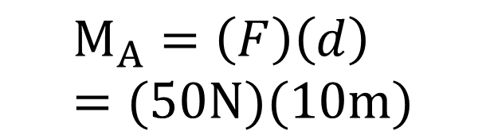
Moment Integrals
Imagine we have a beam with the single force acting on it as shown below
The moment is generally a force times a distance
$$M_{A}=\left(F\right)\left(d\right)=(50N)(10m)$$
50 N
10 m
A

Slide 4
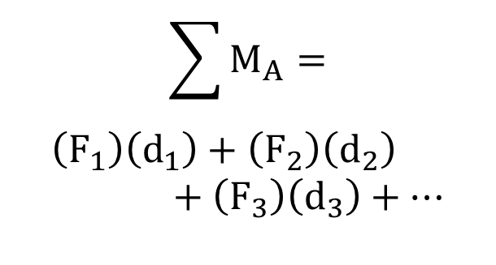
Moment Integrals
If we were to have a number of forces acting on the beam, we could find the total moment exerted by the forces by summing up all the moments from the individual forces
$$\sum{M_{A}}=$$
$$\left(F_{1}\right)\left(d_{1}\right)+\left(F_{2}\right)\left(d_{2}\right)+\left(F_{3}\right)\left(d_{3}\right)+…$$
60 N
50 N
30 N
5 m
2 m
3 m
A

Slide 5
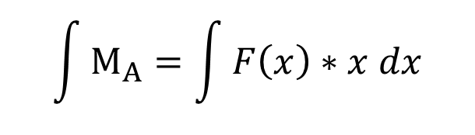
Moment Integrals
For something such as a distributed force, we can imagine it as an infinite number of very small forces.
To “Sum” the moments exerted by all the forces, we will use integration.
$$\int{M_{A}}=\int{F\left(x\right)∗x dx}$$
A

Slide 6
Types of Moment Integrals
This idea of using integrals to sum up the moments (or resistance to moments) is the moment integral.
There are a number of different distinguishing characteristics for moment integrals.
1D, 2D, or 3D
Forces, Areas/Volumes or Mass
First vs. Second
Rectangular vs. Polar
We can potentially have any combination of characteristics from above, but only some combinations have practical purposes

Slide 7
Uses of Moment Integrals
There are many different types of moment integrals, many of which will be useful for many purposes, including...
Calculating the net moment and equivalent point loads for distributed forces.
Finding the centroids and/or center of mass for a body.
Determining a beam’s resistance to bending
Determining a shaft’s resistance to torsion
Determining the mass moments of inertia for a body, which relate moments and angular accelerations.

Slide 8
Determining the Moment Integral
There are many types of moment integrals but we will discuss two methods that will generally be used for calculating these values.
Integration
Determine the mathematical function for the force, area, or mass
Multiply that function by distance or distance squared
Integrate
Method of Composite Parts
Break up your force, area, or volume into pieces.
Look up pre-determined integral values in tables
Combine values to arrive at the final solution

Slide 9
Thanks for Watching
See other engineering mechanics videos and access the full tool at…

